Slide 1

.

Slide 2
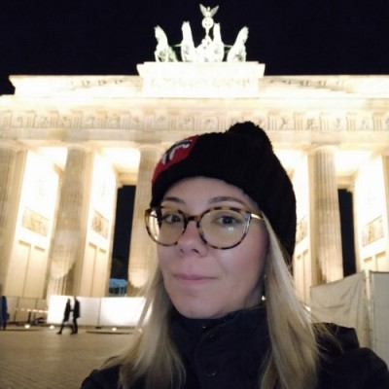


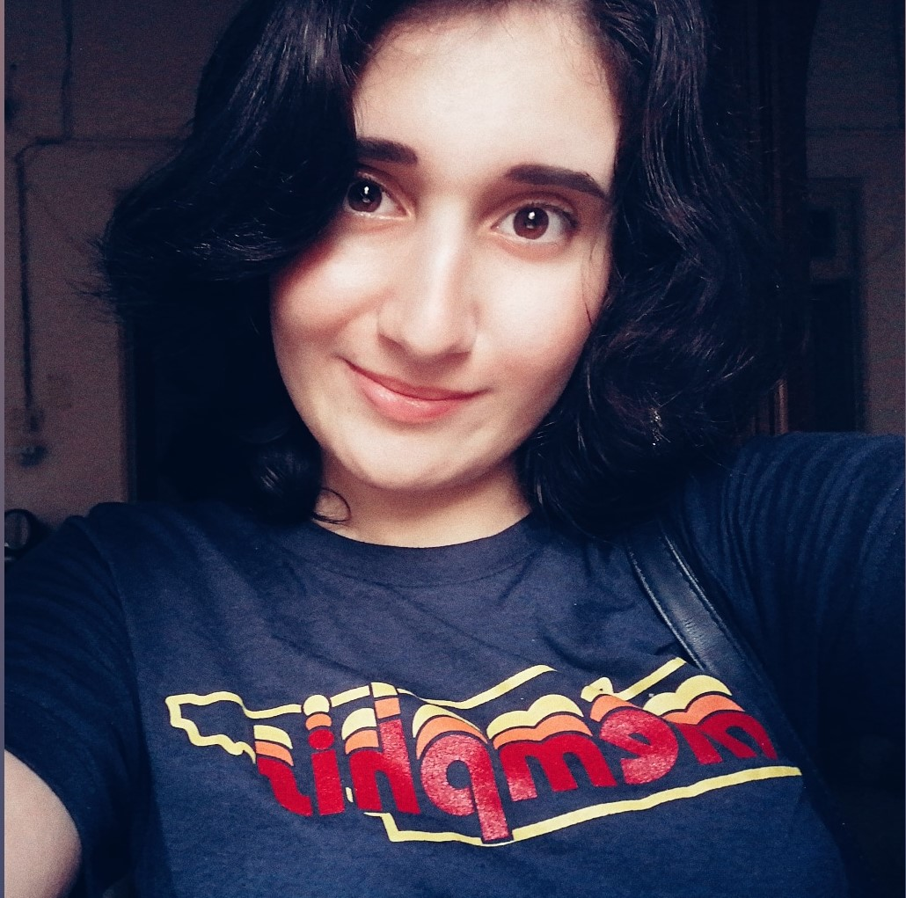

Meet The Team
Angela Distratis
David Barmaz
Ruba Aburub
Harout Mardirossian
Farah Fahhoum
Notes:
Introduce yourself : (Name, Educational background, Work/course name, Country)

Slide 3
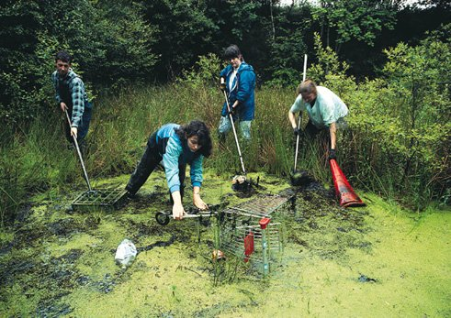
Volunteerism is an important component of any strategy aimed at poverty reduction, sustainable development and social integration [United Nations]
Why Volunteerism is important

Slide 4
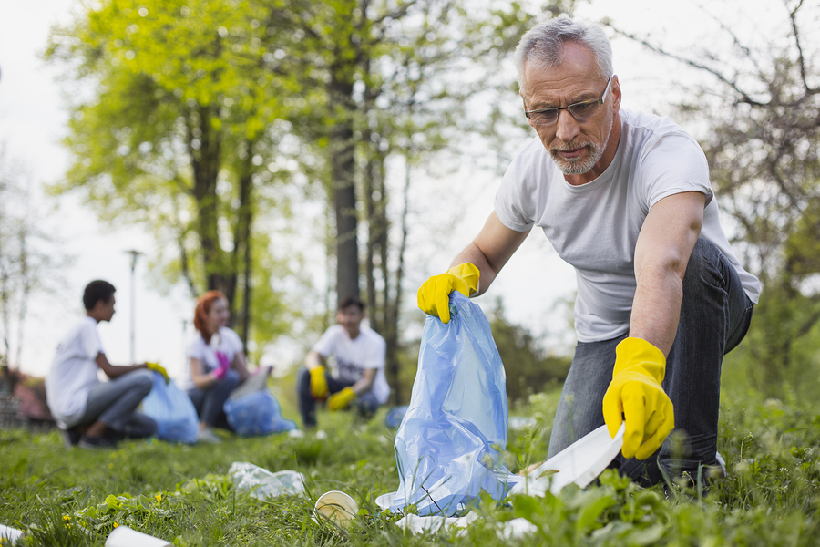
Voluntourism is gaining momentum
Participants in volunteer activities are increasing.
84% of millennials said that they would travel abroad to participate in volunteer activities, and 87% said they wanted to travel sustainably.
Source: Chase 2015

Slide 5
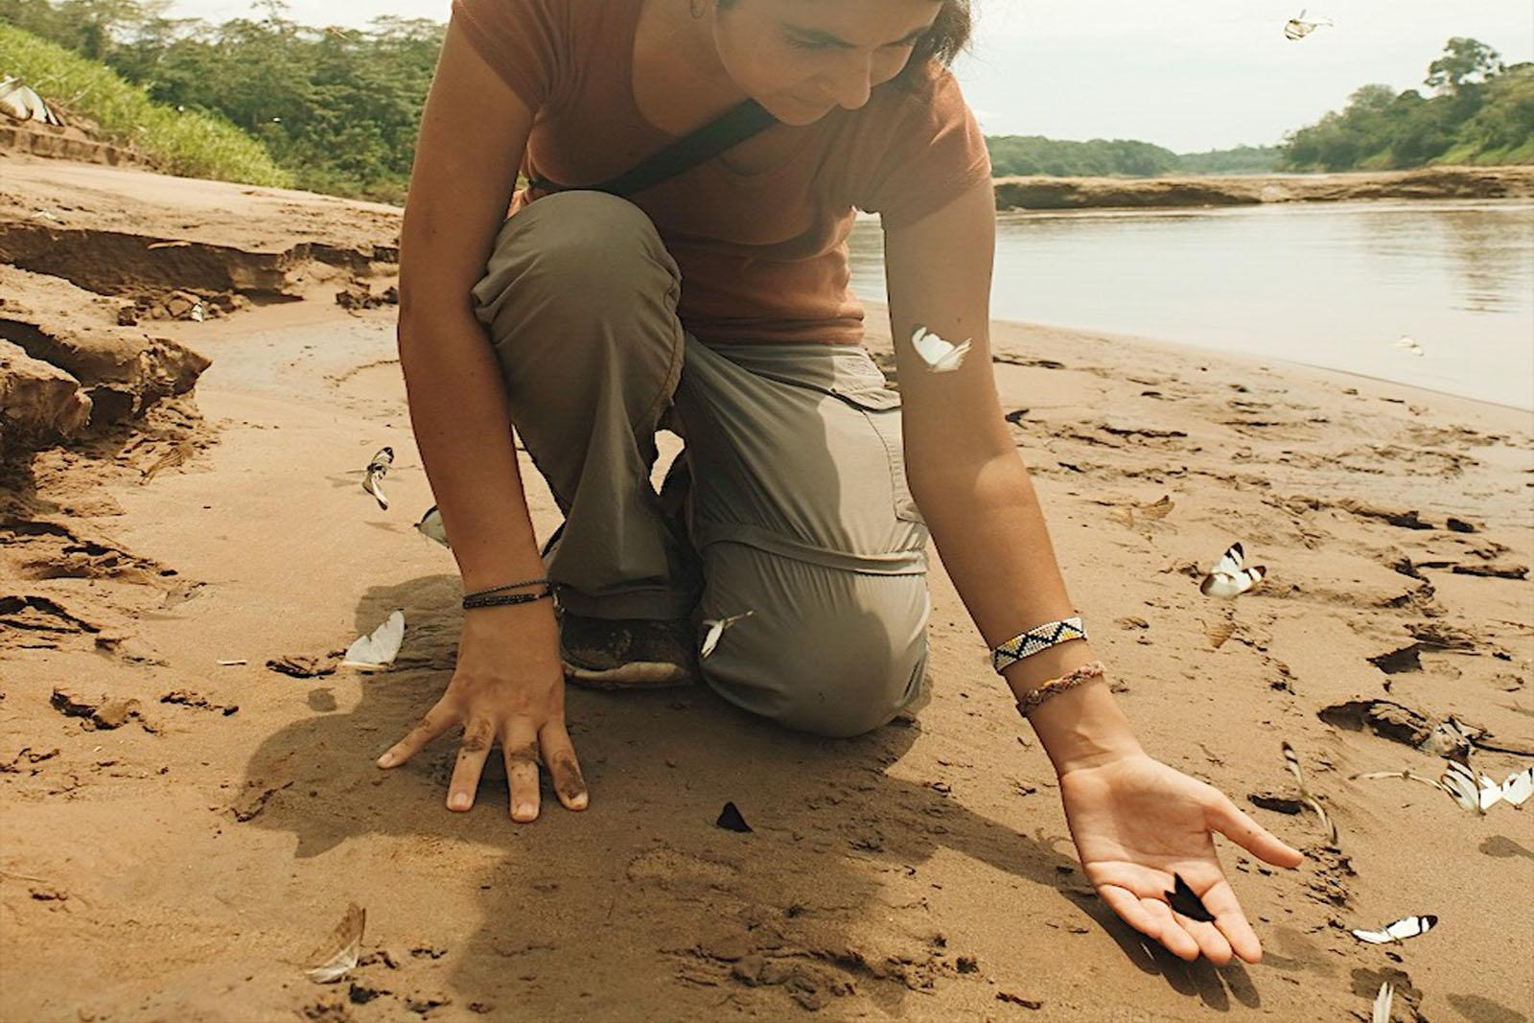
Sustainable tourism is a big business opportunity
70% of global travelers would be more likely to book an accommodation knowing it was eco-friendly & 71% of global travellers think companies should offer more sustainable travel choices.
73% of global travellers intending to stay at least once in an eco-friendly or green accommodation when looking at the year ahead
.
Source: Traveles.org / Booking.com 2019

Slide 6

What is VolunTopia?
VolunTopia is the platform allowing travellers to easily find simple volunteering and Eco-friendly activities they can do while travelling.
Our Mission
Allowing travelers to discover and volunteer at the same time - giving back, protecting the environment and benefiting local communities
Notes:
Why covid inspired us and how?
What is the issue we are trying to solve?

Slide 7
What we are all about!
Volunteering
VolunTopia
Travel
Sustainability

Slide 8
Gamification to increase Impact
Voluntopia is a platform that allows locals to advertise volunteering for Eco- friendly activities that would benefit their communities and the local environment, that involves ratings and rewards.
We created a system that rewards volunteers, that incentivise them to volunteer more, and getting their family and friends engaged with the activity they are doing.
And now, time for the DEMO!

Slide 9

As a seamlessly integrated combination of
Eco-friendly voluntary service in
a destination and the best, traditional elements
of travel – arts, culture, geography, and
history – in your travel ..
We invite you to join us on our journey, and
make VolunTopia, the future of
sustainable travel.

Slide 10
Thank you very much for your attention ! :D
Any Questions?

